Slide 1



SELA DEVELOPER PRACTICE
December 20th-24th 2015
Introduction to React
Sebastian Pederiva
sebastianp@sela.co.il
@spederiva

Slide 2
Agenda
React vs AngularJs
Know React
Components
JSX
Virtual DOM
TODO demo
Why React

Slide 3
Don’t compare React to Angular
The V in the MVC
React is just for views
React don’t provide router, model and event layers

Slide 4
React? What?
React does one thing and does it well
A library for creating user interfaces
Not a framework
Renders your UI and responds to events
Made by Facebook

Slide 6
b
Notes:
Split the application in tiny parts which we can
Handle
Maintain
Test
Each tiny part has only one responsibility

Slide 7
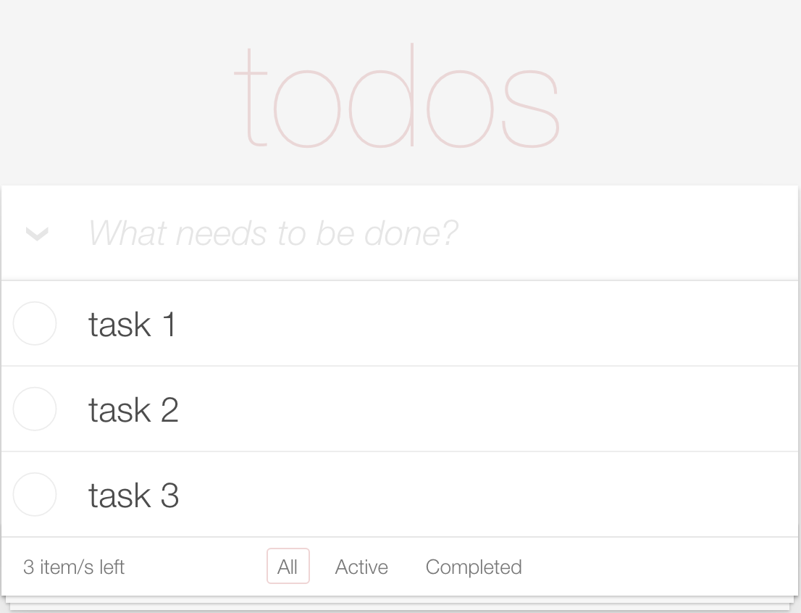
<TODO> <Header></Header> <TodoList></TodoList> <Footer></Footer> </TODO>

Slide 8
React knows to build Components
Encapsulated and interoperable custom elements that extend HTML itself
Build components, not templates
A component should ideally only do one thing
Use components to separate your concerns
var HelloWorld = React.createElement( "h1", null, "Hello World!" );
Notes:
Components are reusable.
Components are composable.
Components are unit testable.
Sample_1_HelloWorld

Slide 9
JSX
XML-LIKE SYNTAX EXTENSION TO ECMASCRIPT
Notes:
Sample_2_HelloWorld

Slide 10
JSX
JSX lets you create JavaScript objects using HTML syntax
Optional
Combines ease-of-use of templates with power of JavaScript
Preprocessor translates to plain JavaScript:
On the fly (suitable during development)
Offline using the React-CLI
http://facebook.github.io/jsx
Notes:
JSX is a JavaScript syntax extension that looks similar to XML. You can use a simple JSX syntactic transform with React.

Slide 11
Setup for JSX transpilers
https://facebook.github.io/react/docs/getting-started.html
Notes:
Sample_3_JSX_Transformer
Browserify & WebPack are builder packages

Slide 12
What about separation of concerns
<div ng-if="showFrom(message)">
<div>From: {{message.from.name}}</div>
</div>
<div ng-if="showCreatedBy(message)"> <div>Created by: {{message.createdBy.name}}</div>
</div>
<div ng-if="showTo(message)"> <div>To: {{message.to.name}}</div>
</div>

Slide 13
Templates separate technologies, not concerns
Reduce coupling, increase cohesion
Coupling: “The degree to which each program module relies on each of the other modules.”
Cohesion: “The degree to which elements of a module belong together.”
Templates encourage a poor separation of concerns.

Slide 14
What about separation of concerns
var HelloWorld = React.createClass({ render(){ var name = getParameterByName("name"), greet; if (name) { greet = <h1>Hello {name}</h1>; } else { greet = <h1>Hello anonymous</h1>; } return ( <div> {greet} </div> ) } });

Slide 15
Props
Props are select pieces of data that are passed to child components from a parent and are immutable by the child
var HelloWorld = React.createClass({ render() { return (<div>Hello {this.props.name}!!</div>); } });
ReactDOM.render( <HelloWorld name="Sebastian" />, document.getElementById("example")
);

Slide 16
State
States are component data that the component sets itself via:
getInitialState
this.setState
State and UI always must be synced
http://facebook.github.io/react/docs/interactivity-and-dynamic-uis.html#what-components-should-have-state
var HelloWorld = React.createClass({ getInitialState(){ return{ name: "" } }, handleOnChange(e){ this.setState({ name: e.target.value }); }, render() { return (<input value={this.state.name} onChange={this.handleOnChange} />); }
});
Notes:
Forget any of your old jQuery habits where you respond to an event and then tweak the DOM
Forget about binding
Any time there's a change, we will re-render the state of our app.
Sample_6_State

Slide 17
State
 | Props | State
Can get initial value from parent Component? | 👍 | 👍
Can be changed by parent Component? | 👍 | ❌
Can set default values inside Component? | 👍 | 👍
Can change inside Component? | ❌ | 👍
Can set initial value for child Components? | 👍 | 👍
Notes:
States
is if you have a component that is changing its own data via click handler or ajax calls on its own behalf and getting data back that it needs if it's going to change its own data only what you're changing is the state
Props
if you have something that the parent at some higher level is going out and making data calls and getting all the required information and his passing that all down to its children that the property

Slide 18
Component Life Cycle
Mounting/Unmounting
Update
getInitialState()
getDefaultProps()
componentWillMount()
render()
componentWillReceiveProps() shouldComponentUpdate()
componentWillUpdate()
render()
* State before and after DOM manipulations
componentDidMount()
componentWillUnmount()
componentDidUpdate()

Slide 19
What with the DOM?
Data
Render
DOM State
Data-Binding
One way binding
Two way binding

Slide 20
What with the DOM?
Re-Render All The Things
Re-render the whole app on every update
Notes:
Sample_7_Trade_ReRender

Slide 21
Virtual DOM
Abstract version of the DOM
Optimized for performance and memory footprint
Create elements for a ”Virtual DOM”
Using React, you usually don't deal with DOM elements directly
Compute minimal set of changes to apply to the DOM
Batch execute all updates
Notes:
Not confuse with ShadowDOM, which is part of WebComponent
Shadow DOM provides encapsulation for the JavaScript, CSS, and templating in a Web Component.
Virtual DOM is a technique and set of libraries / algorithms that allow us to improve front end performance by avoiding direct work with DOM and work only with lightweight JavaScript object that mimic the DOM tree.
Re-render the whole app on every update
Re-rendering on every change makes things simple.
Computes minimal DOM operations
React will intelligently decide what DOM elements stay and go
Most of the virtual DOM can be treated like magic, and you can ignore the implementation
React converts these virtual elements into real DOM elements as necessary
Diff it with the old one

Slide 22
Re-render on Every Update
Every place data is displayed is guaranteed to be up-to-date
No magical data binding
No model dirty checking
No more explicit DOM operations
The re-render will occur when React decides it's ready
Notes:
Modern browsers render 60 times per second, and React hooks into this via requestAnimationFrame

Slide 23
How it works…
React builds a new virtual DOM subtree
…diffs it with the old one
…computes the minimal set of DOM mutations and puts them in a queue
…and batch executes all updates

Slide 24
Making a TODO list

Slide 25
Virtual DOM in other contexts
Server rendering
React Native
https://facebook.github.io/react-native
React-Canvas
https://github.com/Flipboard/react-canvas

Slide 26
React-Canvas
React Canvas adds the ability for React components to render to <canvas> rather than DOM
Made by Flipboard
https://github.com/Flipboard/react-canvas
Samples
http://floppybox.baylaunch.com/
https://react.rocks/tag/Canvas
Notes:
Sample – Sample_8_React_Canvas
Npm start

Slide 27
Why React?
Simplify code
Build Reusable Components
Virtual DOM
Build Isomorphic apps
Eliminate querying / modifying DOM
Small API / Easy to learn & remember
Same architecture, different output
Notes:
Isomorphic apps: Shared JavaScript that runs on both the client & server
Hybrid apps are developed using HTML, CSS and Javascript, and then wrapped in a native application using platforms like Cordova

